Slide 1
CS303B Assignment1
Yihan Sun, Xudong Zhang, Xuhan Kong
Department of Electronic and Electrical Engineering, SUSTech
CS303B: Artificial Intelligence B
1

Slide 2
Outline
Part A: Composite image generation
System and Algorithm Design
Experimental Results
Part B: Binary image classification
System and Algorithm Design
Experimental Results
Part C: Deduplication and re-identification
System and Algorithm Design
Experimental Results
Conclusion
CS303B: Artificial Intelligence B
2

Slide 3
Outline
Part A: Composite image generation
System and Algorithm Design
Experimental Results
Part B: Binary image classification
System and Algorithm Design
Experimental Results
Part C: Deduplication and re-identification
System and Algorithm Design
Experimental Results
Conclusion
CS303B: Artificial Intelligence B
3

Slide 4
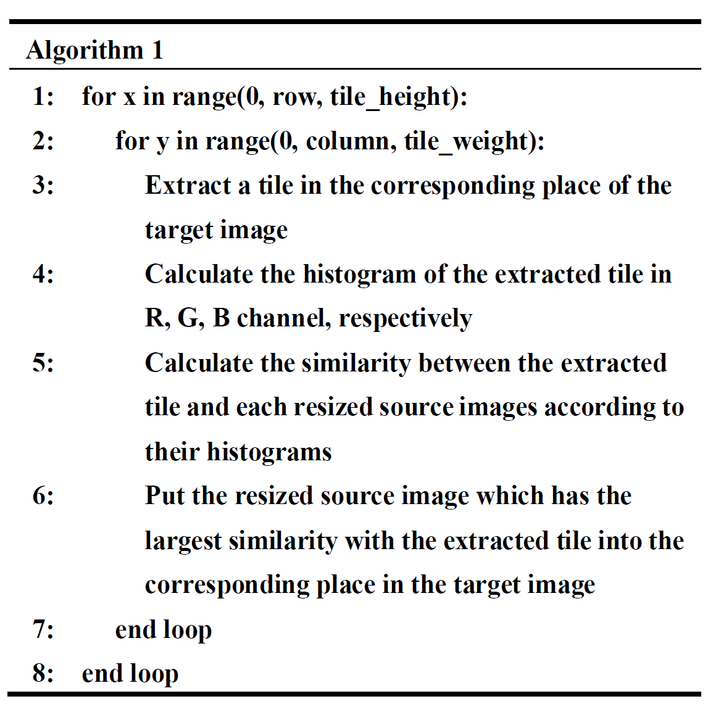
System and Algorithm Design
Histogram
Similarity
CS303B: Artificial Intelligence B
4

Slide 5
System and Algorithm Design
Compare the Similarity of Histograms
Correlation-based Approaches
Bhattacharyya Distance
Euclidean Distance
Chi-Square Distance
Histogram Intersection
CS303B: Artificial Intelligence B
5

Slide 6
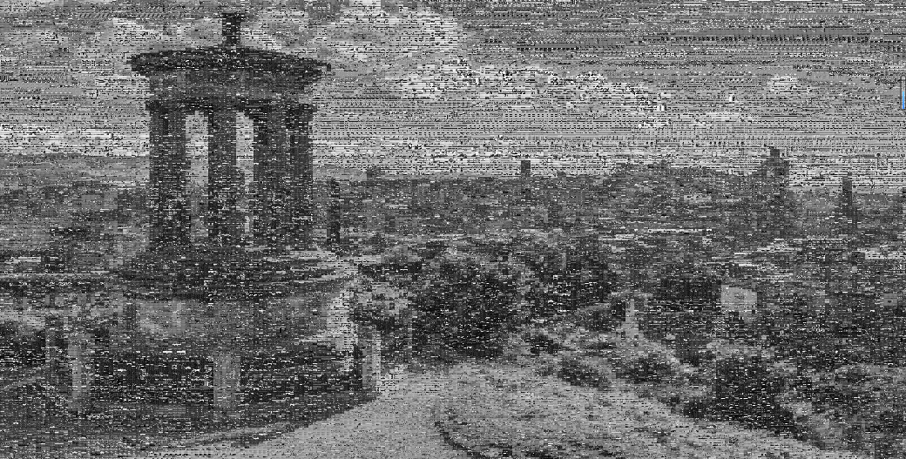
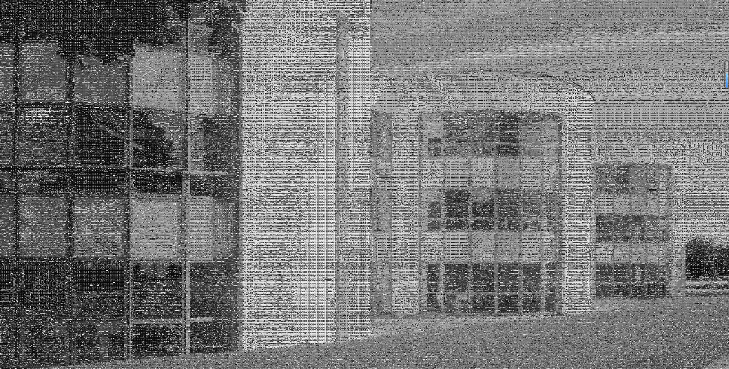


Experimental Results
Grayscale Composite Image
200$×$200 Grayscale
400$×$400 Grayscale
CS303B: Artificial Intelligence B
6

Slide 7
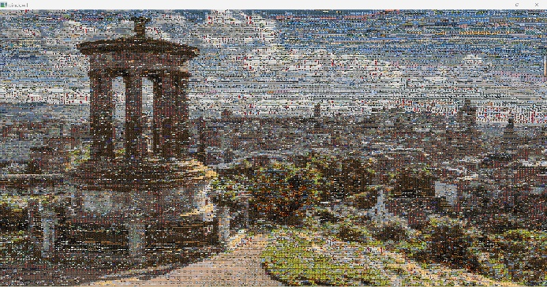
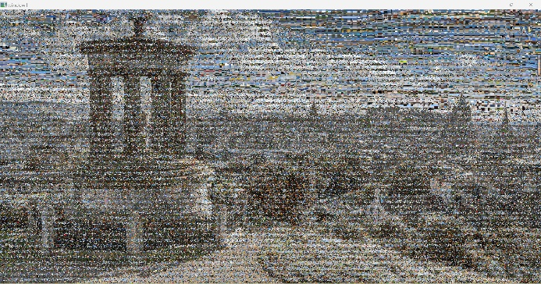



Experimental Results
Composite Image 1
200$×$200
400$×6$00
600$×6$00
CS303B: Artificial Intelligence B
7

Slide 8
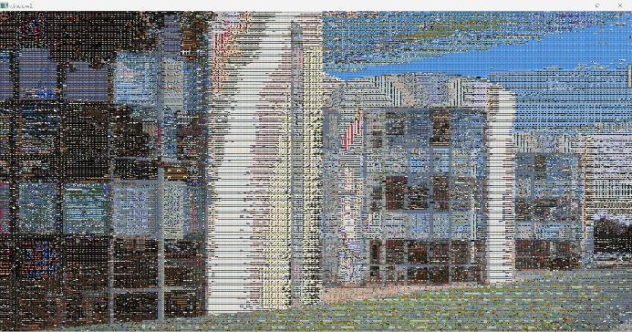
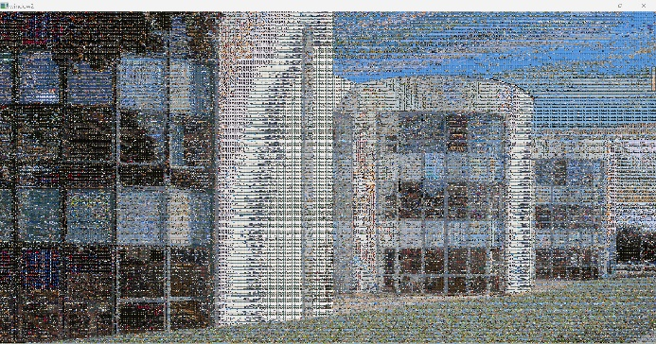
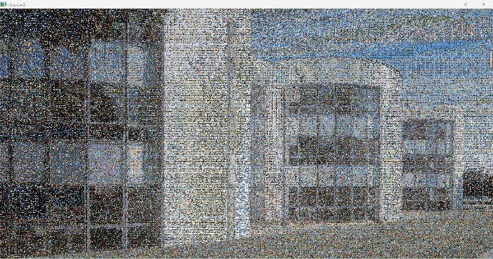


Experimental Results
Composite Image 2
200$×$200
400$×4$00
800$×$800
CS303B: Artificial Intelligence B
8

Slide 9
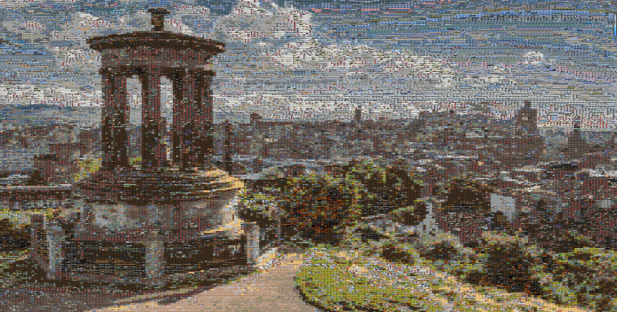
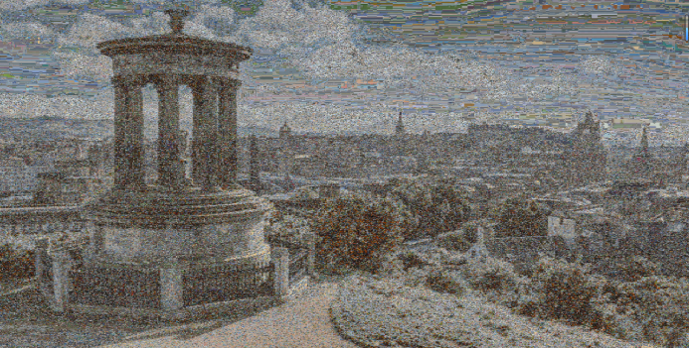
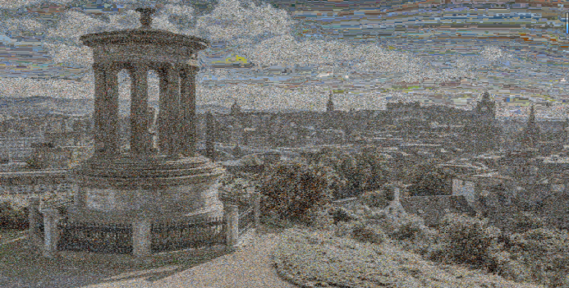


Experimental Results
Composite Image 1 (Gaussian Filter)
200$×$200
400$×$600
600$×$600
CS303B: Artificial Intelligence B
9

Slide 10
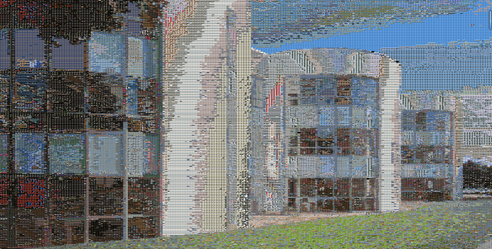
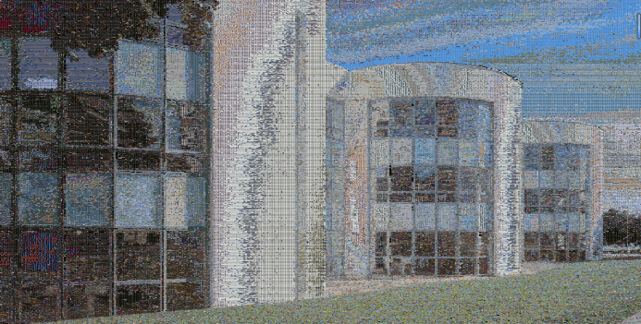
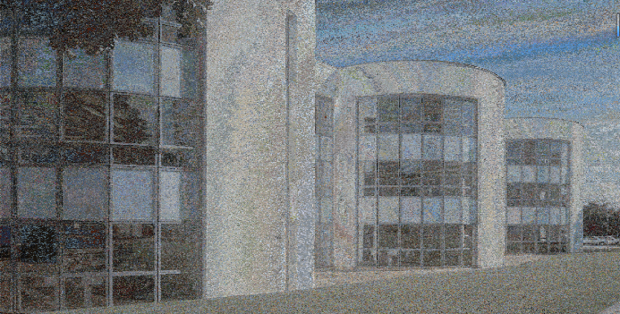

Experimental Results
Composite Image 2 (Gaussian Filter)
200$×$200
400$×$400
800$×$800
CS303B: Artificial Intelligence B
10

Slide 11
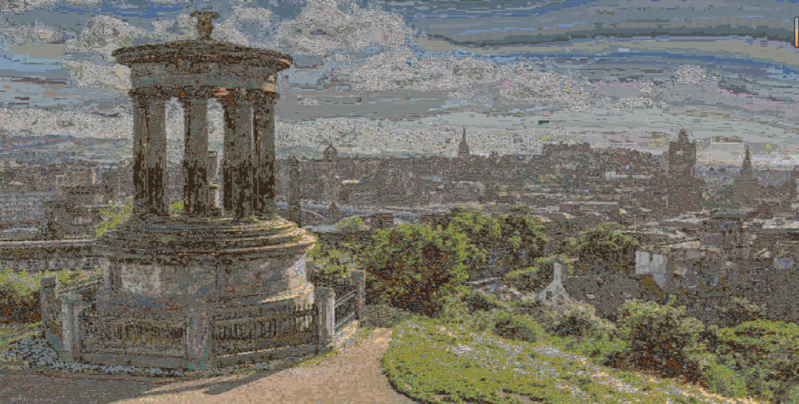
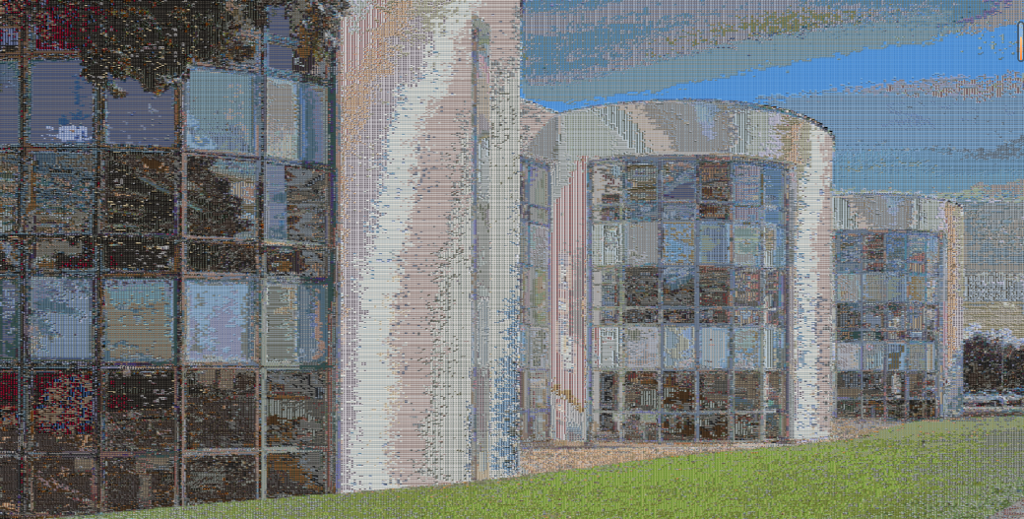


Experimental Results
Composite Image (Improvement)
400$×$600 Target Image 1
400$×$400 Target Image 2
CS303B: Artificial Intelligence B
11

Slide 12
Outline
Part A: Composite image generation
System and Algorithm Design
Experimental Results
Part B: Binary image classification
System and Algorithm Design
Experimental Results
Part C: Deduplication and re-identification
System and Algorithm Design
Experimental Results
Conclusion
CS303B: Artificial Intelligence B
12

Slide 13
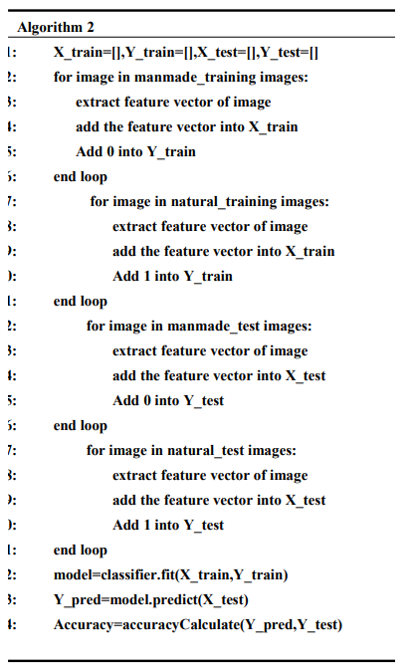
System and Algorithm Design
Feature vector extraction
classification
CS303B: Artificial Intelligence B
13

Slide 14
System and Algorithm Design
Feature vector extraction
Histogram distribution of RGB channels
Histogram of Oriented Gradient
Scale-Invariant Feature Transform
CS303B: Artificial Intelligence B
14

Slide 15
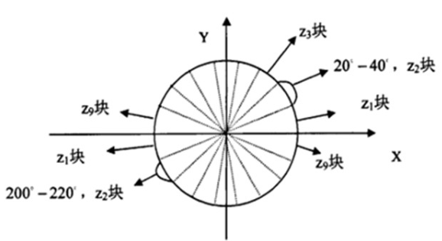
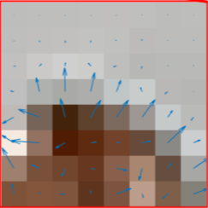
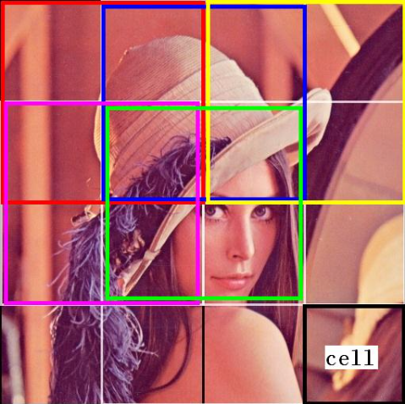
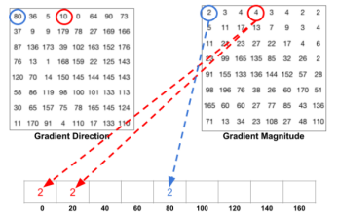
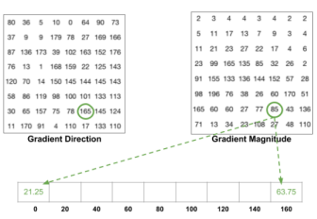
Feature vector extraction
Histogram of Oriented Gradient
CS303B: Artificial Intelligence B
15

Slide 16
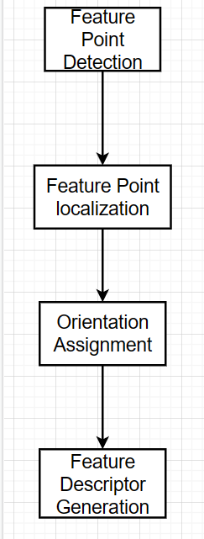
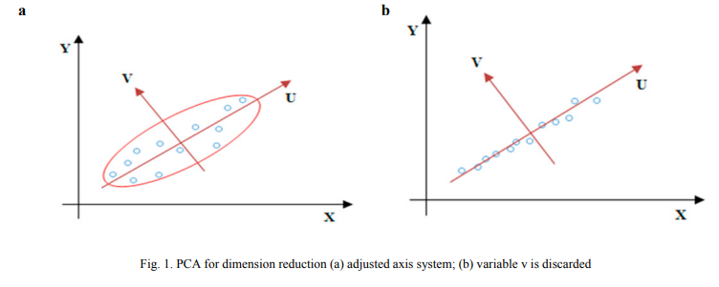
Feature vector extraction
Scale-Invariant Feature Transform
CS303B: Artificial Intelligence B
16

Slide 17
System and Algorithm Design
Classification
K-nearest Neighbor Classifier
Support Vector Machine
CS303B: Artificial Intelligence B
17

Slide 18
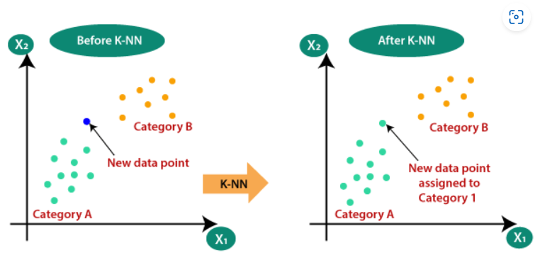
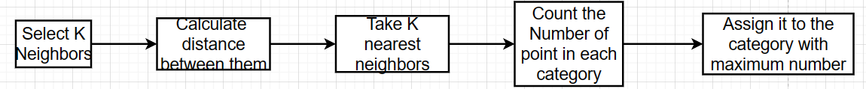
Classification
K-nearest Neighbor Classifier
CS303B: Artificial Intelligence B
18

Slide 19
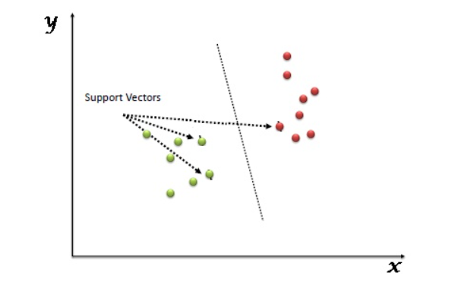
Classification
Support Vector Machine
CS303B: Artificial Intelligence B
19

Slide 20
Experimental Results
CS303B: Artificial Intelligence B
20

Slide 21
Experimental Results
CS303B: Artificial Intelligence B
21

Slide 22
Experimental Results

Slide 23
Outline
Part A: Composite image generation
System and Algorithm Design
Experimental Results
Part B: Binary image classification
System and Algorithm Design
Experimental Results
Part C: Deduplication and re-identification
System and Algorithm Design
Experimental Results
Conclusion
CS303B: Artificial Intelligence B
23

Slide 24
System and Algorithm Design
Cosine similarity：
Represent an image as a vector and measure the similarity between two images by calculating the cosine distance between the vectors. Cosine similarity algorithm: The cosine value between the angles between two vectors in a vector space is used to measure the difference between two individuals.
$$\begin{aligned}&cos⁡(θ)=\frac{a^{2}+b^{2}−c^{2}}{2ab} \\ & =\frac{x_{1}^{2}+y_{1}^{2}+x_{2}^{2}+y_{2}^{2}−(x_{2}−x_{1})^{2}−(y_{2}−y_{1})^{2}}{2\sqrt{x_{1}^{2}+y_{1}^{2}}∗\sqrt{x_{2}^{2}+y_{2}^{2}}}. \\ & =\frac{x_{1}∗x_{2}+y_{1}∗y_{2}}{\sqrt{x_{1}^{2}+y_{1}^{2}}∗\sqrt{x_{2}^{2}+y_{2}^{2}}}ψ\end{aligned}$$
CS303B: Artificial Intelligence B
24

Slide 25
System and Algorithm Design
HASH similarity：
The essence of Hash algorithm for image similarity recognition is to hash transform images, generate a set of binary numbers, and then find similar images by comparing the hash value distances of different images.
The perceptual hash algorithm is a more robust algorithm than the mean hash algorithm, which differs from the mean hash algorithm in that the perceptual hash algorithm obtains low-frequency information of images through DCT (Discrete Cosine Transform).
CS303B: Artificial Intelligence B
25

Slide 26
System and Algorithm Design
SSIM structural similarity：
The SSIM algorithm is mainly used to detect the similarity between two images of the same size, or to detect the degree of image distortion. The SSIM formula is based on three comparative measures between samples x and y: brightness, contrast, and structure.
$$SSIM(x,y)=\frac{(2μ_{x}μ_{y}+C1)(2σ_{xy}+C2)}{({μ_{x}}^{2}+{μ_{y}}^{2}+C1)({σ_{x}}^{2}+{σ_{y}}^{2}+C2)}$$
$$I(x,y)=\frac{2μ_{x}μ_{y}+C1}{{μ_{x}}^{2}+{μ_{y}}^{2}+C1},μ_{x}=\frac{1}{N}\sum_{i=1}^{N}{x_{i}}$$
$$c(x,y)=\frac{2σ_{x}σ_{y}+C2}{{σ_{x}}^{2}+{σ_{y}}^{2}+C2}$$
$$s\left(x,y\right)=\frac{σ_{xy}+C3}{σ_{x}σ_{y}+C3}$$
Brightness:
Contrast:
Structure:
t
CS303B: Artificial Intelligence B
26

Slide 27
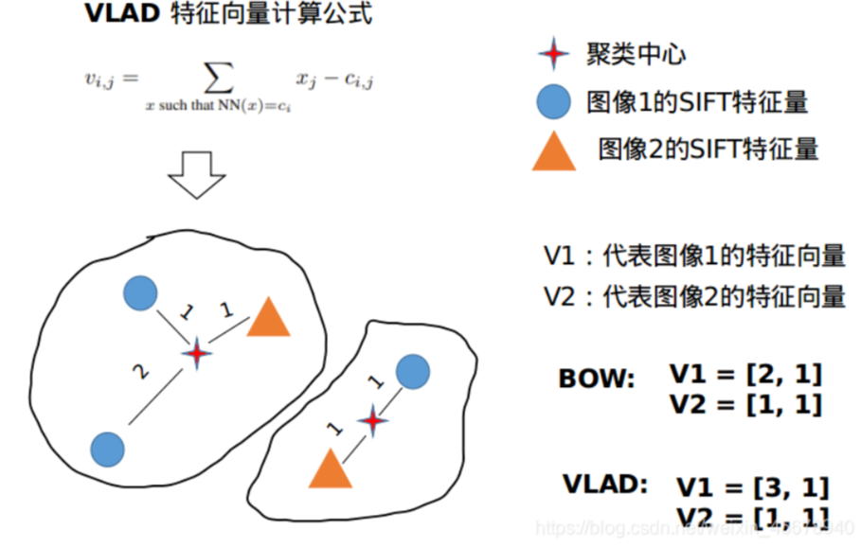
System and Algorithm Design
VLAD similarity：
The main method is to train a small codebook through clustering methods, find the nearest codebook clustering center for each feature in the image, and then accumulate the differences between all features and the clustering center to obtain a vlad matrix of k * d, where k is the number of clustering centers and d is the feature dimension (such as sift being 128 dimensions). Then, expand the matrix to a vector of (k * d) dimensions and normalize its L2, resulting in a vector called VLAD
CS303B: Artificial Intelligence B
27

Slide 28

System and Algorithm Design
Filter
0
1
2
….
CS303B: Artificial Intelligence B
28

Slide 29

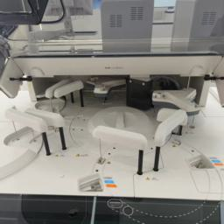
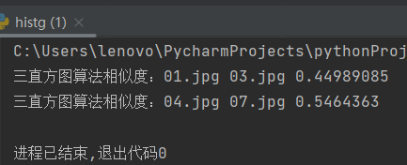
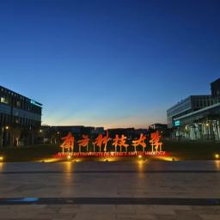

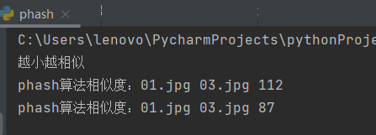
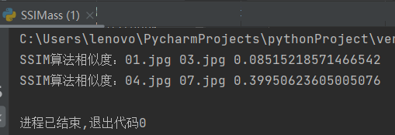
Experimental Results
Evaluation:
01.jpg
03.jpg
04.jpg
07.jpg
CS303B: Artificial Intelligence B
29

Slide 30
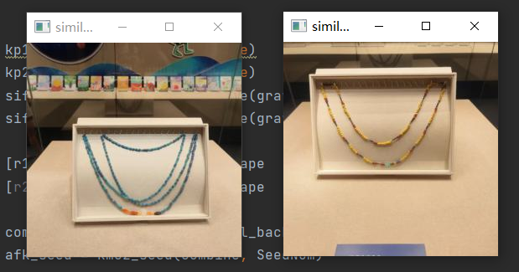
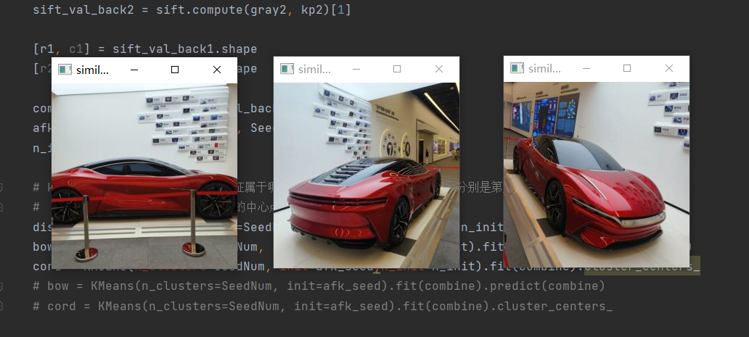
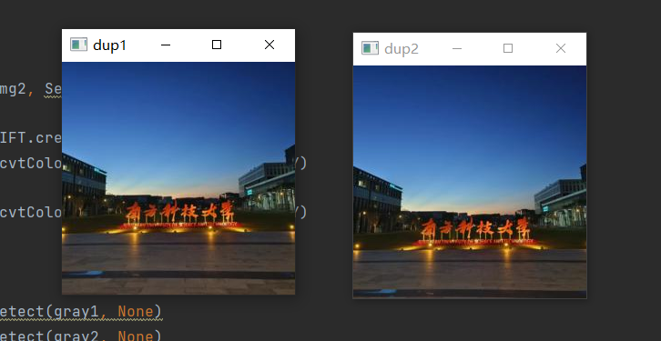
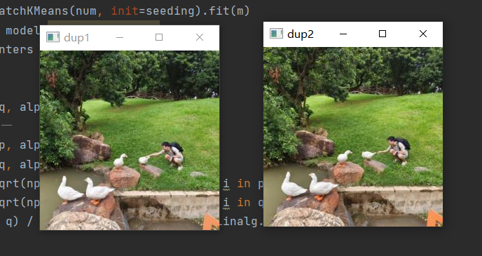
Experimental Results
Results:
CS303B: Artificial Intelligence B
30

Slide 31
Outline
Part A: Composite image generation
System and Algorithm Design
Experimental Results
Part B: Binary image classification
System and Algorithm Design
Experimental Results
Part C: Deduplication and re-identification
System and Algorithm Design
Experimental Results
Conclusion
CS303B: Artificial Intelligence B
31

Slide 32
Conclusion
Composite the target images of various types
Execute binary image classification
Deduplicate nearly identical pictures and pick out similar pictures with good performance
CS303B: Artificial Intelligence B
32

Slide 33
Acknowledgement
Thank you !
CS303B: Artificial Intelligence B
33

